Slide 1


ELECTRONIC VOTING MACHINE
CENTURION UNIVERSITY OF TECHNOLOGY AND MANAGEMENT
VIZIANAGARAM , AP - 535003
.
PROGRAMMING IN C
PRESENTED BY
RAJA PREM SAI – 221801390008
BHASKAR VISWANADH – 221801350019
NAGA SAI PREETHAM – 221801350007
SAI KIRAN – 221801350002
ROHITH VINAY – 221801350017
JAI SANDESH – 221801390003
GUIDED BY:
Sri. B. Lakshman Rao

Slide 2
1
ABSTRACT
2
EXISTING SYSTEM
3
PROPOSED SYSTEM
4
SYSTEM REQUIREMENTS
CONTENTS
5
PROJECT ARCHITECTURE
6
MODULES
7
UML DIAGRAMS
8
OUTPUT SCREENS
9
CONCLUSION

Slide 3
ABSTRACT
ELECTRONIC VOTING MACHINE

Slide 4
ABSTRACT
01
Electronic Voting Machine (EVM) is a simple electronic device used to record votes in place of ballot papers and boxes which were used earlier in conventional voting system.
All earlier elections be it state elections or central elections a voter used to cast his/her favorite candidate by putting the stamp against his/her name and then folding the ballot paper as per a prescribed method before putting it in the Ballot Box.
This is a long, time-consuming process and very much prone to errors. This situation continued till election scene was completely changed by electronic voting machine.
No more ballot paper, ballot boxes, stamping, etc. all this condensed into a simple box called ballot unit of the electronic voting machine. Because EVM cannot be easily misplaced, forged, or shared, they are considered more reliable for person recognition than traditional token or knowledge based methods.
So the Electronic voting system has to be improved based on the current technologies.
This project discusses the Electronic Voting Machine by using the software program in C.
ELECTRONIC VOTING MACHINE

Slide 5
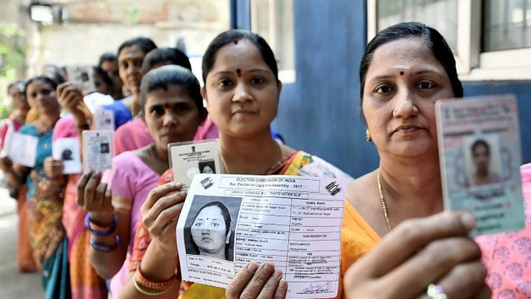
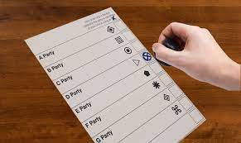

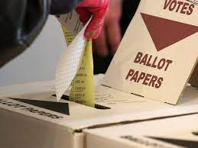

EXISTING SYSTEM
MANUAL
VOTER
VERIFICATION
STAMPING ON BALLOT PAPER
DEPOSITING BALLOT PAPERS INTO BALLOT BOX
FOLDING BALLOT PAPER
02

Slide 6


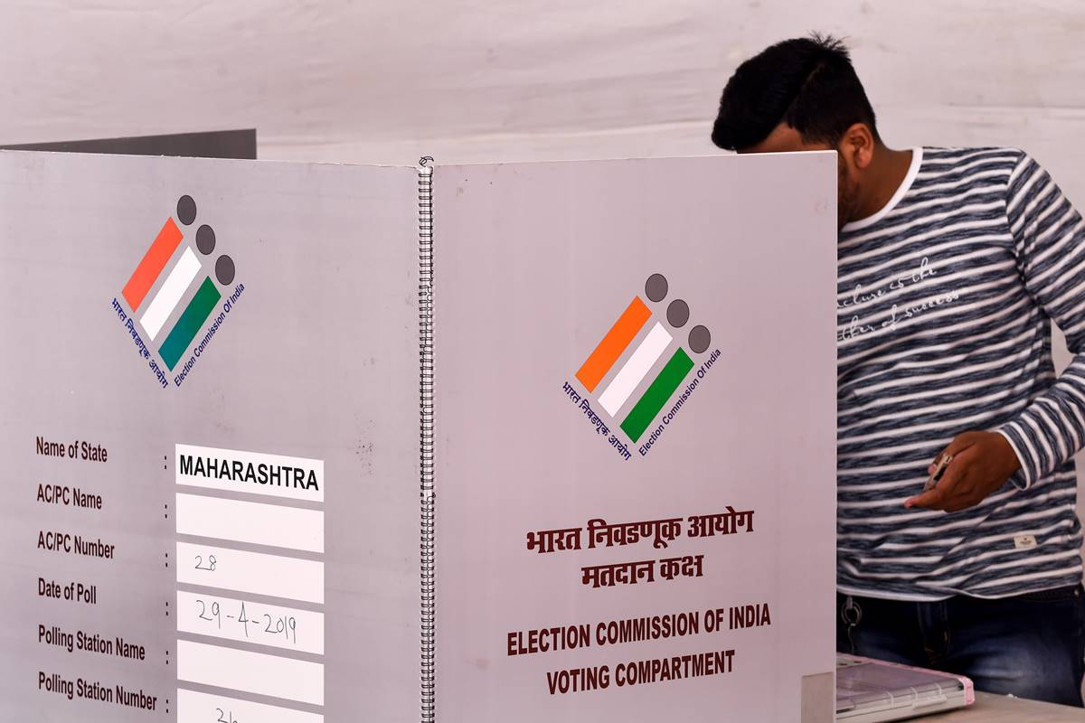
PROPOSED SYSTEM
MANUAL VOTER VERIFICATION
VOTER LOGIN INTO EVM’S AND CASTING THEIR VOTE
SINGLE KEY OPERATION
03

Slide 7


04
Windows 7 or later version.
MINIMUM HARDWARE REQUIREMENTS
LAPTOP
DUAL CORE PROCESSOR
2GB RAM & 256GB HARDISK
REQUIREMENTS
NOTEPAD
TEXT EDITOR
SUBLIME TEXT
MINIMUM SOFTWARE REQUIREMENTS
COMPILER
MinGW
DEV C + +
OPEN SOURCE IDE’S
CODEBLOCKS
V S CODE

Slide 8

PROJECT ARCHITECTURE
VOTER PORTAL
VOTER REGISTRATION
VOTER ID VERIFICATION
ADMIN PORTAL
LOGIN USING USERNAME AND PASSWORD
LOGIN USING USERNAME AND PASSWORD
DISPLAY CANDIDATES
CANDIDATE REGISTRATION
VIEW RESULTS
VOTING THEIR DESIRED CANDIDATES
Exit
05

Slide 9

PROJECT ARCHITECTURE
Voters Registration | Voting
Admin’s Portal
Voting Results
Login using password and contenders registration
Creating a individual unique id and password for each individual voter.
Voters cast their votes in EVM’s
Admin declares the voting result
05

Slide 10




MODULE DESCRIPTION
VOTERS REGISTRATION
ADMIN
LOGIN
LIVE RESULT
VOTING RESULT
VOTER
LOGIN
CASTING VOTE TO
DESIRED CANDIDATES
06

Slide 11
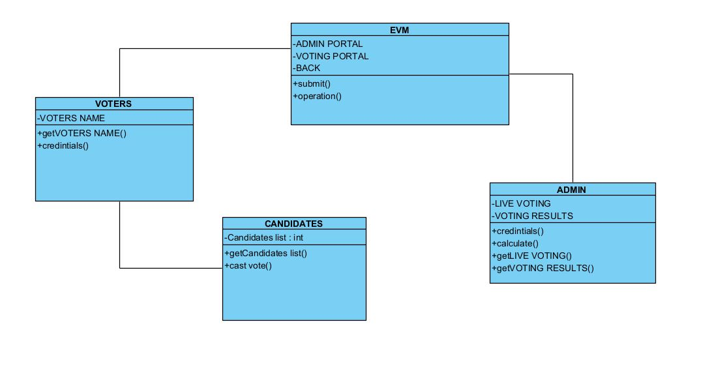
UML DIAGRAMS
CLASS DIAGRAM
07

Slide 12
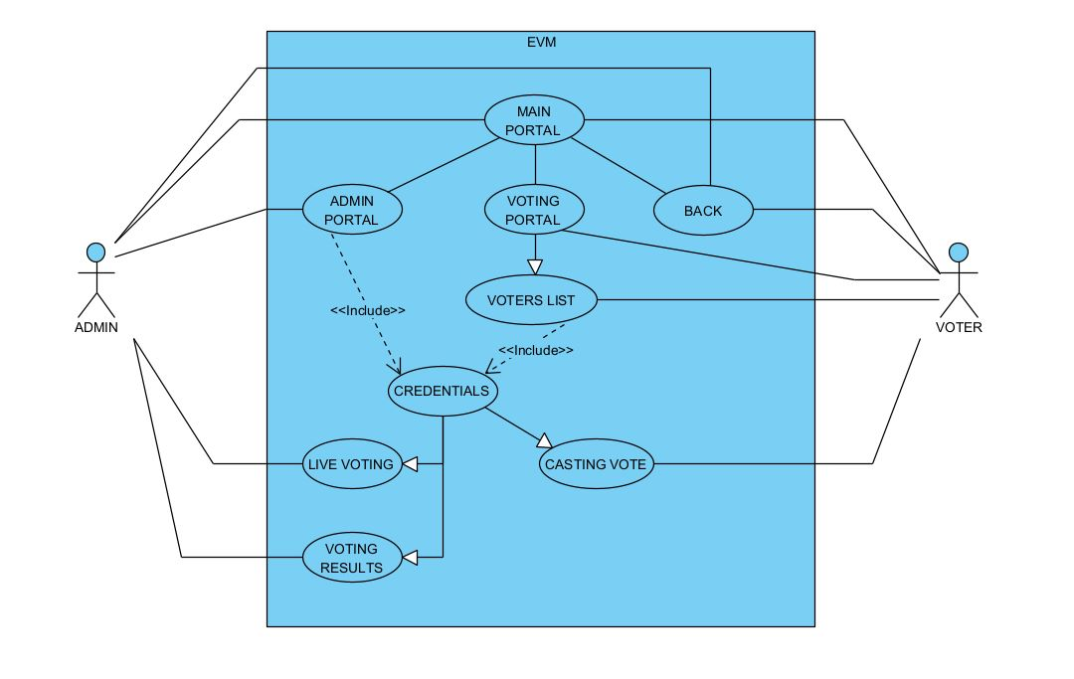
UML DIAGRAMS
USE CASE DIAGRAM
07

Slide 13
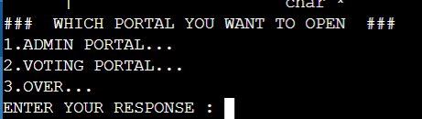
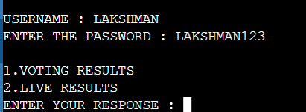
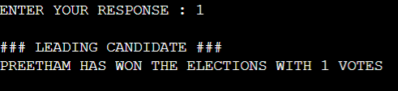
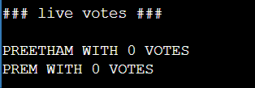
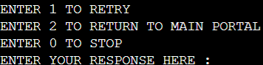
OUTPUT SCREENS
OUTPUT SCREENS FOR ADMIN PORTAL
08

Slide 14
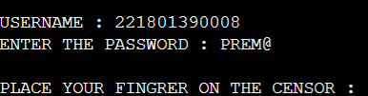
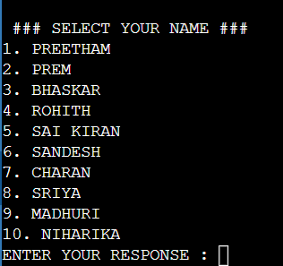
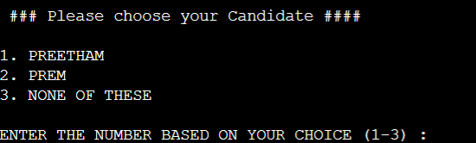
OUTPUT SCREENS
OUTPUT SCREENS FOR VOTER PORTAL
08

Slide 15
CONLUSION

Slide 16
CONLUSION
We have successfully created a system that can accept votes from users and store them securely in a database
Electronic voting system is an effort in the direction to use computer for the purpose of voting system. It is both user friendly as well as time saving.
Emphasis has been given in this application to replicate all the process required in a traditional system.
EVM system is self-sufficient with all the information required about the voters, candidate and the voters. Once the information is fed to the system, it can identify individual voters, their votes and then can press any key to return such as counting the votes has been simplified in this system.
The basic function of the polling has been reduced to single key operation.
07

